Slide 1
Azure iot hub
Raffaele Aldrigo | Backend developer

Slide 2
Meeting agenda
Introduction
Iot services on Azure
Azure Iot Hub overview
Break & team building
Hands-on part 1
Hands-on part 2
Q&A

Slide 3
Labcamp objectives
What you’ll learn
In this labcamp you will build a c# application that will use Azure Iot,
In particular:
Read messages sent from devices to the cloud (d2c messages)
Send messages to devices (c2d messages)
Read devices reported properties using device twin
Call methods on devices (direct methods)
Notes:
«Cos’è Iot?»

Slide 4




NEW GENERATION TELEMATICS IN CNHI
This project is developed in cooperation with Microsoft that provides strategic vision and governance while Reply collaborates on solution design and is responsible for development and test of solution.
As a result, more than 5000 worldwide connected vehicles will be using this platform in the following 3 years.

Slide 5
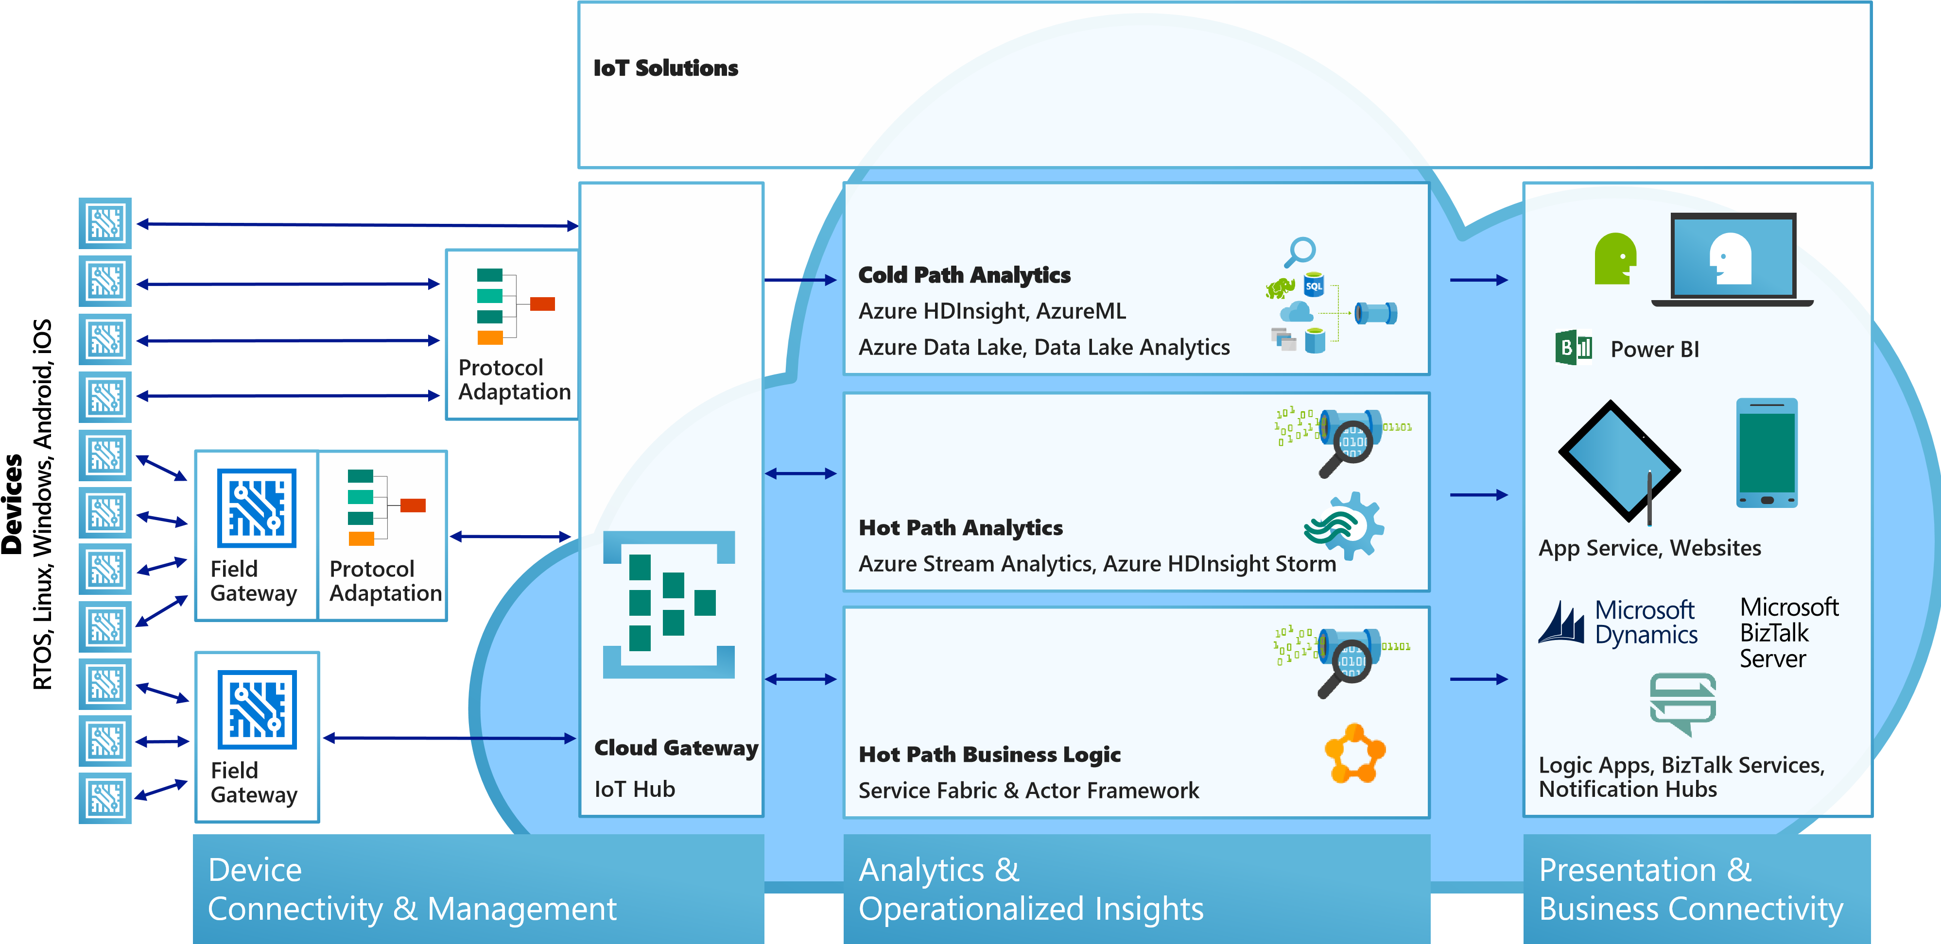
Iot on azure
Store and analyze later:
Machine learning, data mining, predictive maintenance, visualization
A device can be connected to Azure Iot Hub in 3 different ways:
Directly, by using Azure IotHub SDK
Protocol adaptation, using: HTTPs, MQTT, AMPQ
Field gateway
Use data once received to make decisions

Slide 6
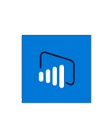

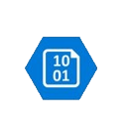



Azure services for iot
Azure Stream Analytics
Real time stream processing for billions of Iot Devices
Power BI
Dashboards and data connectors to visualize any data
Azure Storage
Blob, SQL, DocumentDB, Data Lake, Cosmos DB. Storage to meet every need at the scale of IoT
Azure Service Bus
Queue and topics
Azure App Service
Web and mobile apps for any platform on any device
Azure Iot Hub
Connect, secure, communicate, monitor and manage billions of devices
And more...
Notes:
Aggiungere Service Bus (queue e topic) e aprofondire ogni servizio (1 slide x servizio)

Slide 7
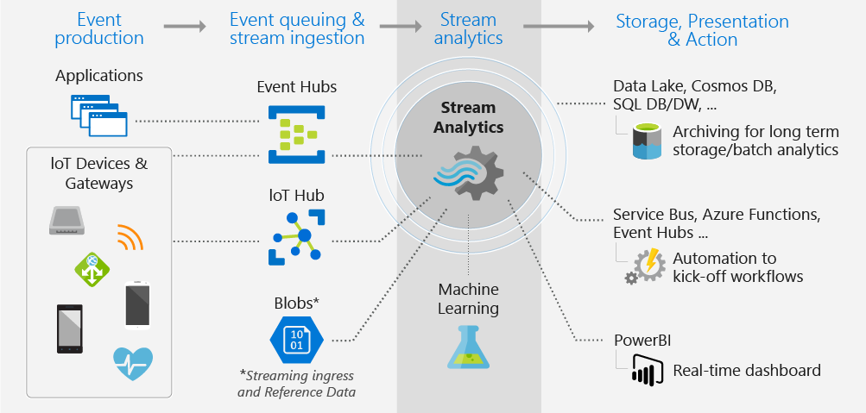
Stream analytics
Azure Stream Analytics is an event-processing engine that allows you to examine high volumes of data streaming from various sources.
It also supports extracting information from data streams, identifying patterns, and relationships to trigger actions.
It works with an SQL-like query
SELECT
*
INTO
[YourOutputAlias]
FROM
[YourInputAlias]

Slide 8
Azure storage

Slide 9
Web apps

Slide 10
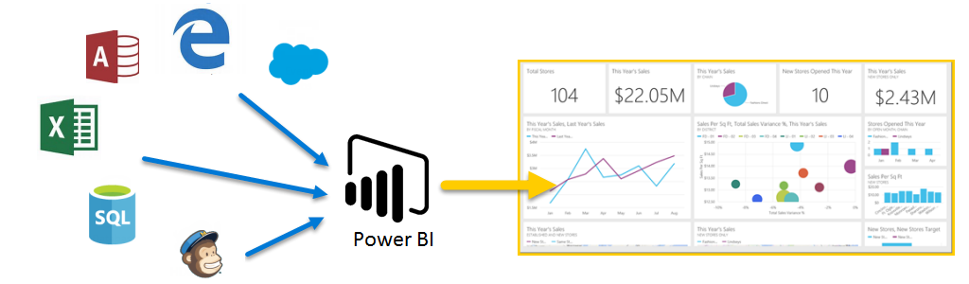
Power bi
Gather and process data from various sources (ETL)
Visualize data by making dashboards accessible on all devices!

Slide 11
Queue
Service bus
Dead letter
Queue
Complete / abbandon
message
message
Service bus is namespace container for queue (and topics)
Azure queue are LIFOs
A completed message is removed from the queue.
Notes:
Dire che la coda ha una certa capienza e che i messaggi hanno una scadenza (tutto configurabile)
«Per l’hands-on vi verrà dato un consumer group, ovvero teamXX»

Slide 12
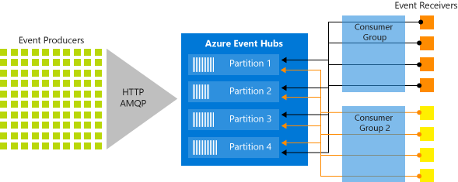
Event hub
Event Hubs provides message stream handling capability but has characteristics that are different from traditional enterprise messaging. Event Hubs capabilities are built around high throughput and event processing scenarios.
Event producers: Publishers can publish events using HTTPS or AMQP…
Partitions: Each consumer only reads a specific subset, or partition, of the message stream.
Consumer groups: Consumer groups enable multiple consuming applications to read the stream independently at their own pace and with their own offsets.
Event receivers: Any entity that reads event data from an event hub.

Slide 13
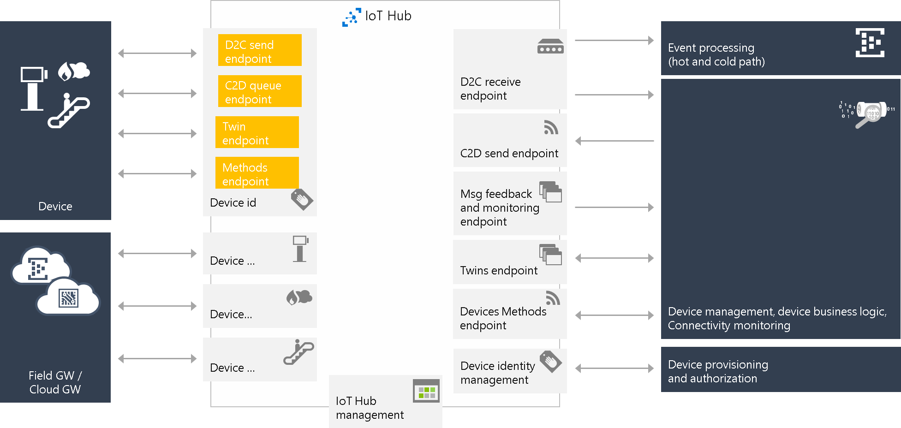
Iot hub endpoints
Notes:
Partire dall’identity, twin, device methods e poi d2c e c2d. Spezzare slide in due: iniziare con una slide di creazione di un iot hub da portale azure, registrazione di un device e poi parlare della parte in giallo

Slide 14
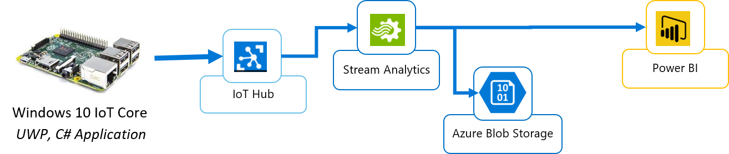
Sample iot app
Get sensor data from device
Send data to the «cloud» -> Azure Iot Hub
Extract data from Azure IoT Hub from d2c queue
Store (Blob storage) and Analyze data (Power BI)
Notes:
Spezzare slide a blocchi

Slide 15
Device application
To access Iot Hub functions we need a key. On the IoT Hub we can define various policies, and we will have one key for each policy.
How to create a device app: https://goo.gl/Uz3HEb
deviceClient = DeviceClient.Create(iotHubUri, new DeviceAuthenticationWithRegistrySymmetricKey(deviceId, deviceKey), TransportType.Mqtt);
//update twin
var twin = await deviceClient.GetTwinAsync();
var reportedProperties = new TwinCollection();
reportedProperties["key"] = ...;
await deviceClient.UpdateReportedPropertiesAsync(reportedProperties);
await deviceClient.SetMethodHandlerAsync("deviceMethod", DeviceMethod, null);
Task.WaitAll( SendDeviceToCloudMessagesAsync(), ReceiveC2dAsync() );
Notes:
Aggiungere definizioni

Slide 16
private static async Task SendDeviceToCloudMessagesAsync(CancellationToken ct) {
while (!ct.IsCancellationRequested) {
var telemetryDataPoint = ...
var message = new Message(Encoding.ASCII.GetBytes(JsonConvert.SerializeObject(telemetryDataPoint)));
await deviceClient.SendEventAsync(message);
await Task.Delay(3000);
}
}
private static async Task ReceiveC2dAsync(CancellationToken ct) {
while (!ct.IsCancellationRequested) {
Message receivedMessage = await deviceClient.ReceiveAsync();
if (receivedMessage == null) continue;
string content = Encoding.ASCII.GetString(receivedMessage.GetBytes());
...
await deviceClient.CompleteAsync(receivedMessage);
}
}
public static Task<MethodResponse> DeviceMethod(MethodRequest methodRequest, object userContext){
...
}
Notes:
Spezzare in 3 slide

Slide 17


Slide 18
Hands-on checklist
Visual Studio (or Visual Studio Code) with C# console application
Let’s subdivide in teams (max 20)
Download common library: https://goo.gl/oHTLcv
Create a new c# solution with a console app and reference IotLab.Common
Install NuGet Microsoft.Azure.Devices
Notes:
Cosa andate a fare voi oggi.
<immsgine e contesto odiessea nello spazio

Slide 19
Break & Team building

Slide 20

On your marks
Get set
Code!

Slide 21
device 2 cloud messages
https://goo.gl/4QsYpF
eventHubClient = EventHubClient.CreateFromConnectionString(Config.IotHub.ConnectionStringService, "messages/events");
var partitions = eventHubClient.GetRuntimeInformation().PartitionIds;
foreach (string partition in partitions) {
ReceiveMessagesFromDeviceAsync(partition, cts.Token));
}
private static async Task ReceiveMessagesFromDeviceAsync(string partition) {
var eventHubReceiver = eventHubClient.GetConsumerGroup("teamXX").CreateReceiver(partition, DateTime.UtcNow);
while (true) {
EventData eventData = await eventHubReceiver.ReceiveAsync();
...
}
}

Slide 22
2) Send Cloud 2 Device messages
Guide: https://goo.gl/eucTrp
3) Read device twin reported properties
Guide: https://goo.gl/rqjLTv
4) Invoke direct method
var methodInvocation = new CloudToDeviceMethod(…);
methodInvocation.SetPayloadJson(…);
serviceClient.InvokeDeviceMethodAsync(…);

Slide 23
Q&A

Slide 24

THANKS Giuseppe Catonio
Mirko Rubaldo
Valentina Valle

